Slide 1
1SL2000. GE business management
Session 2 - strategy

Slide 2
The course outline
Session 1. the Company / CDA case study
Session 2. Strategy & Innov° / SEB case study
Session 3. Management / Dyson case study
Session 4. Strategic marketing / Nutella case study
Session 5. Operational mktg / LUSH case study
Session 6. Business Dev / Blablacar case study
Session 7. Value Chain / Zara case study
Session 8. Digital transfo / Value chain digital transfo
Session 9. Organizations / Rana Plaza case study
Session 10. Wrap-up / Essilor case study

Slide 3
Content of the session
Analysis tools (Competitive analysis)
Generic strategies (Competitive advantage)
Innovation Creative destruction
Definition The strategic approach

Slide 4
1. What is strategy?
4

Slide 5
The strategic mode
Military origin of strategy: the art of leading the army to victory.
Acting strategically
It means defining goals and the means to achieve them.
It means taking into account the environment, the competition, etc.
Who does strategy?
The leader, strategist more than administrator!
The analyst or strategist (consulting - BCG)

Slide 6
A definition of the company's strategy
The strategy consists of allocating resources
... aiming at long-term objectives: long term means uncertainty!
... in order to gain a competitive advantage (over competitors)
Strategic decisions are only neither operational nor tactical :
Choose the markets in which to be present
Develop the necessary activities: INVEST

Slide 7
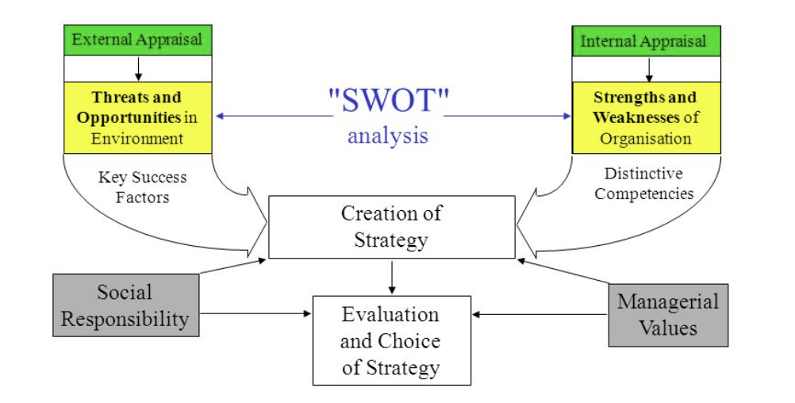
The LCAG analysis process
Values and preferences of the company (managers / corporate body)
Determine
possibilities for action
Environmental values and preferences (external stakeholders)

Slide 8
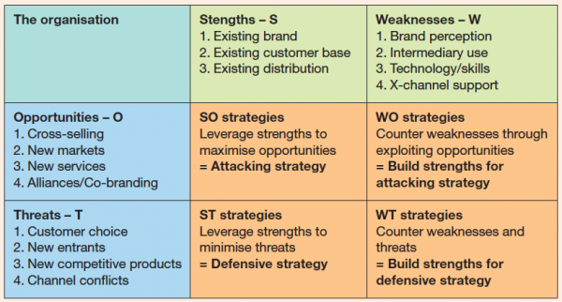
e.g. SWOT analysis / strategic TOWS

Slide 9
2. Strategic analysis tools

Slide 10
Strategic analysis tools and methods
 | Internal analysis (the company) | External analysis (the environment)
Corporate strategy (Portfolio) | Analysis of the managerial system (business / mission / vision) | Environmental Scan (PESTEL)
Business strategy (Advantage) | Value chain, (Analysis of resources and skills) | Competitive analysis (Porter's Model - 5 forces )

Slide 11
Analysis of the managerial system
What are the company's business lines/missions?
Know who she is and what she wants (to do / to be)
Specify the activities, in terms of
know-how, products, markets, competition
Who holds the power in the company?
Know who determines the goals of the organization.
Share VS Stake holders
VW, Wolfburg, Lower Saxony

Slide 12
The strategy guides the allocation of resources
Where to play ?
By defining the job and a specific way of exercising this job and formulating its mission
a corporate identity / culture (mission statement)
Through vision on how to achieve a high level of performance in its sector of activity
a business model
a leadership style
How to win ?
Notes:
12

Slide 13
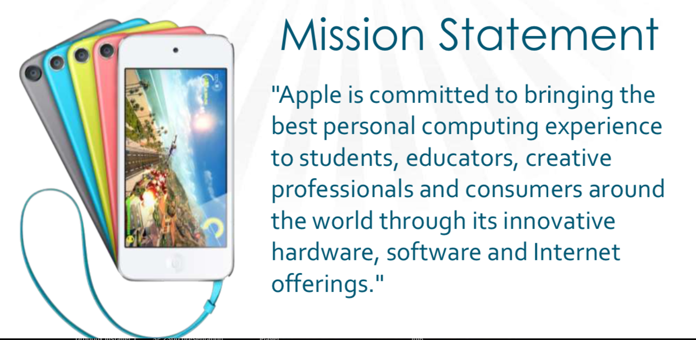
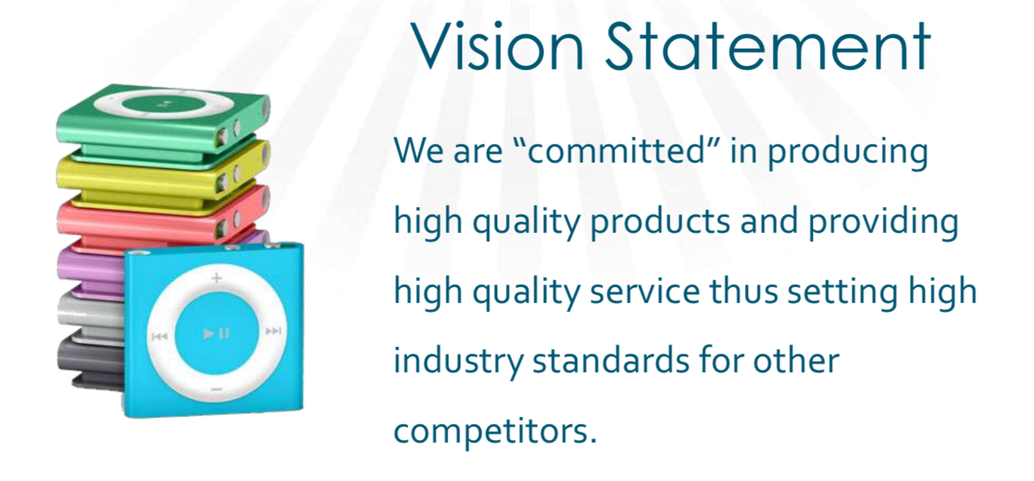

Slide 14
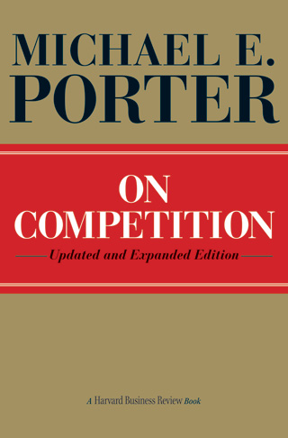
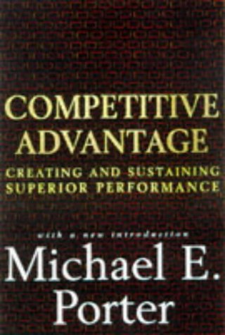
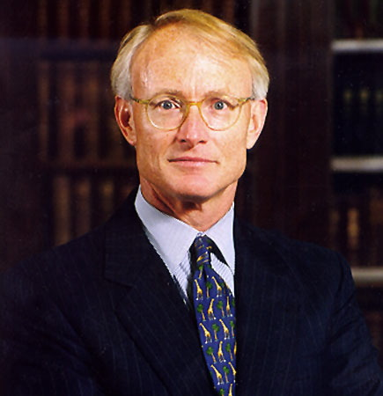
Competitive analysis (competitive analysis)
Popularized by Michael Porter and based on the industrial economy (sectors, industries), it states that :
The state of competition in a given sector depends on five fundamental forces
The higher the intensity of these forces, the lower the potential profitability of the activity.
Analysis of sector dynamics and competitive logic

Slide 15
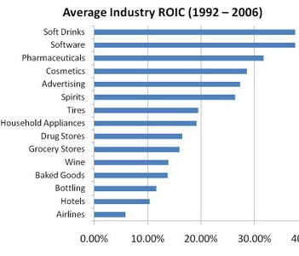
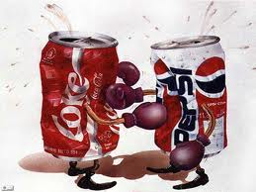
At the high end are industries like soft drinks and prepackaged software, which have been almost six times more profitable than the airline industry

Slide 16
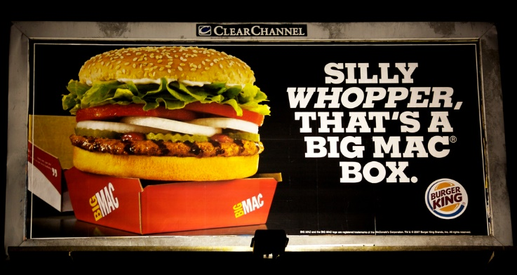
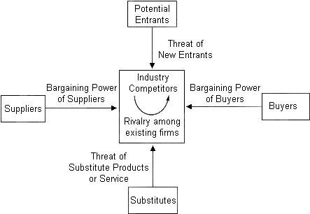
The 5 competitive forces - (THE Porter's model, but not the only one!) http://hbr.org/2008/01/the-five-competitive-forces-that-shape-strategy/

Slide 17
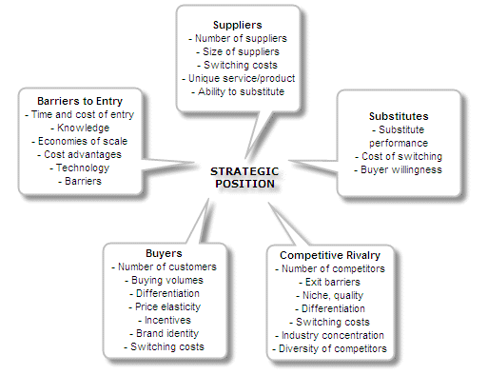
Key determinants of the intensity of competitive forces. Note the importance of entry barriers to protect the sector from new entrants and the role of regulation (6th force)

Slide 18
3. Generic strategies

Slide 19
Competitive advantage
Ability to create more value than its competitors (notion of rent)
Do better or do it differently
Rent-ability
Specific and sustainable competence that creates the conditions for imperfect competition and leads to superior profitability.
Louis Vuitton: mass luxury (brand image & accessibility)

Slide 20
Value creation and competitive advantage
Value perceived by customer
Value delivered to the customer
Price
Value captured by the company
Costs

Slide 21
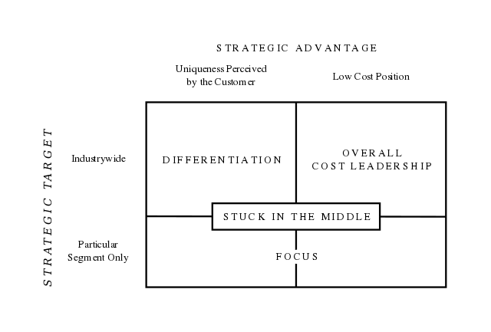
Generic strategies

Slide 22
The Cost Advantage
Cost competitiveness can play on
Factor cost: labour, material
Cost of operations: productivity,
…
Two very different modalities
By volumes: commodities, components,
Through efficiency: Ikéa (standardization, simplification)
Do not confuse operational efficiency (improving operations) with strategy
design different activities or ways of doing business from these competitors

Slide 23
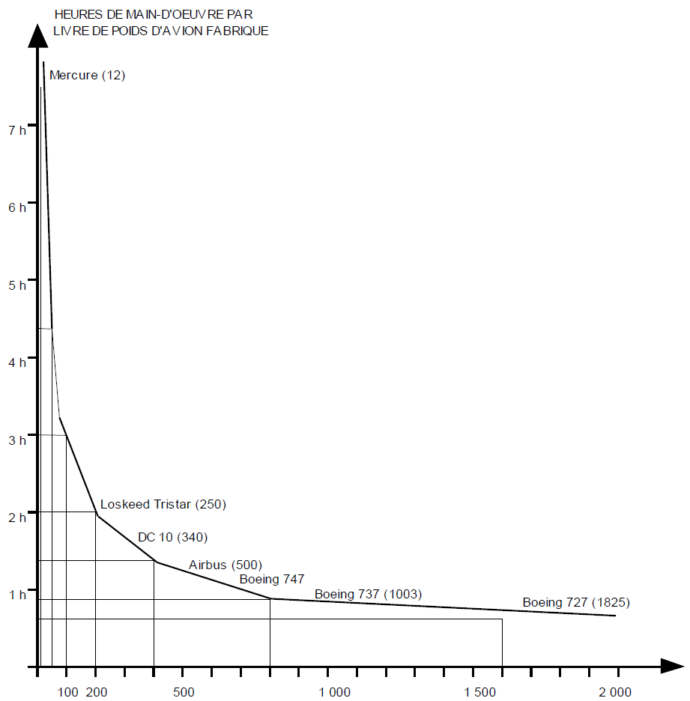
Cost/Volume Strategy: The Experience Effect
The experience curve: decrease at a constant rate in the unit cost of a product with each doubling of the cumulated production!
Economies of scale: reduction of unit equipment and production costs
distribution of fixed costs,
position of strength (bargaining power)
Learning effects: gradual improvement of working methods
better execution of the tasks to be accomplished
better mastery of know-how.
better use of the manufacturing process
Premium to the leader in cumulative production
Cost / volume domination strategy
23

Slide 24
Differentiation strategy
Non-cost competitiveness: distinguishing oneself by means other than price
Propose a differentiated offer
original compared to the competition,
difficult to imitate
recognized and valued by a broad target audience
at a reasonable cost (surcharge >> premium price)
Associated with innovation, quality and image
Combining the contributions of the different functions

Slide 25
Differentiations
3️⃣
« Premium »
HIGH
Domination by sophistication
Share gains
4️⃣
Niche Premium
« No-go zone »
Premium
Offering
5️⃣
Disruption
Reference offering
1️⃣
VALUE
Domination by costs
Value
Offering
« Value »
2️⃣
Niche Value
LOW
LOW
PRICE
HIGH

Slide 26
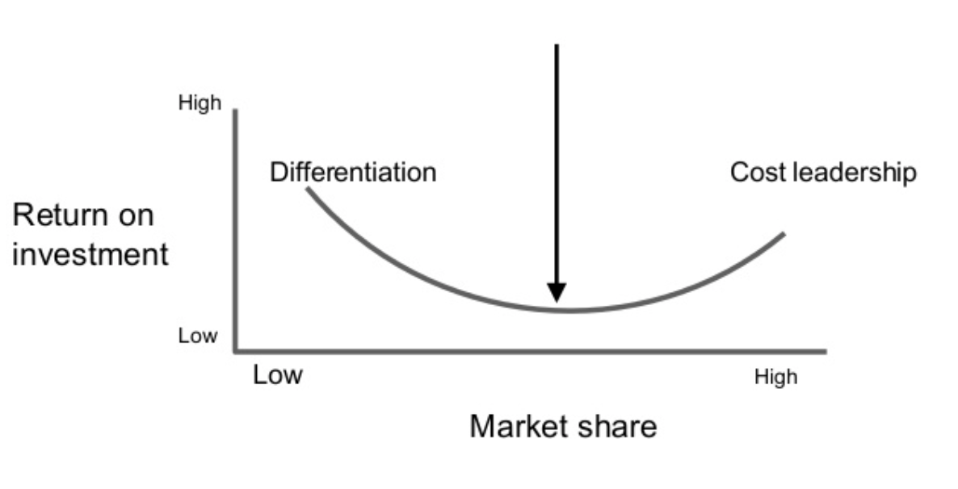
Strategies combining cost and differentiation
Two opposing logics?
Choosing between cost and differentiation
Stuck in the middle ?
Price and cost may vary in opposite directions
Volumes / cost AND high price: Essilor
Differentiated AND Low cost: Ryanair VS Easyjet
A logic of performance multidimensional and cumulative
Cost AND Quality AND Flexibility AND Adaptability (ZARA)
Stuck in the middle
26

Slide 27
The business portfolio (scope of consolidation) and the nature of synergies between activities
Industrial synergies : Scale VS Scope
Economies of scale : mass production
Financial synergies: according to the life cycle
Which activities consume cash flow?
Economies of scope : efficiency by variety
Which activities generate cash flow?
knowing how to finance growth before maturity

Slide 28



The BCG Matrix: Combining experience curve and life cycle to diagnose a company's portfolio of activities
?
STARS
INVEST TO MAINTAIN POSITION
DilemmAs
INVEST
Segment
Abandon
HIGH
GROWTH RATE
CASH COWS
MILK
INVEST MINIMALLY
DEAD WEIGHTS
Maintain without investments or abandon
LOW
HIGH
LOW
RELATIVE MARKET SHARE

Slide 29
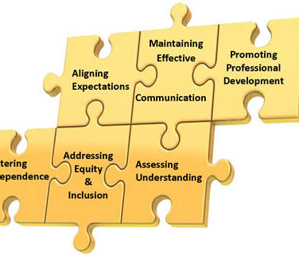
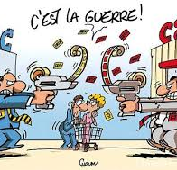
In the end, 2 schools of thought
Strategy is real estate
Emphasis on skills development
Analyse interne : Resource-based view (Edith Penrose)
Strategy is war
Primacy to positioning in an environment
External analysis: Competitive analysis (Michael Porter)

Slide 30
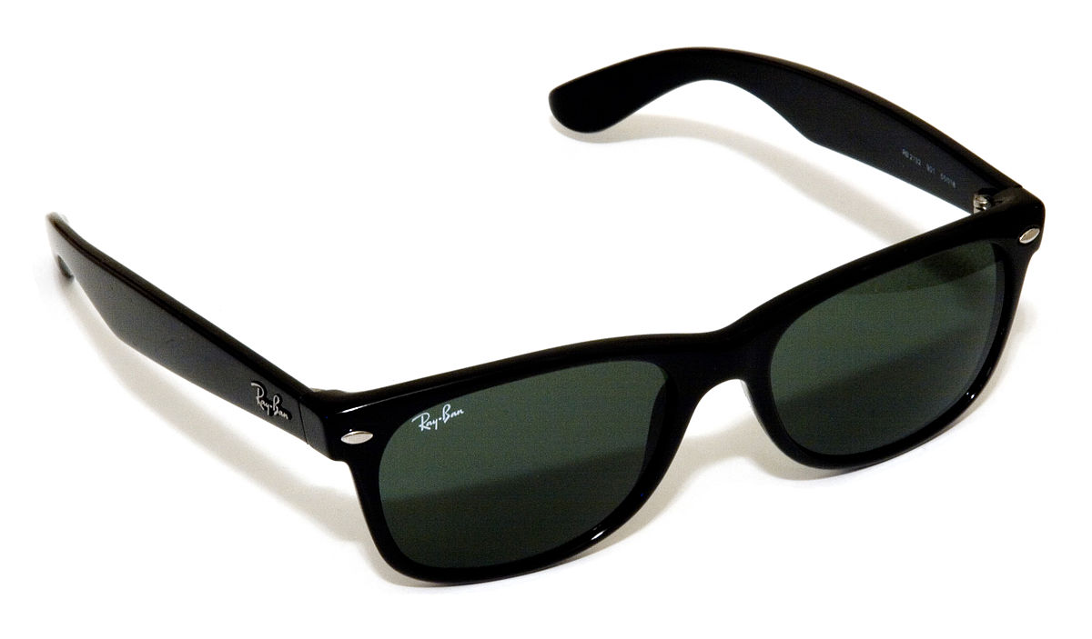
The VIP model - Value - Imitation - Scope
Which model of VALUE creation should be used to ensure sustainable profits for the company (what is its business model)?
Is it possible to avoid IMITATION of this value creation model by competitors in order to gain a competitive advantage?
On what scope is this value creation model deployed?

Slide 31
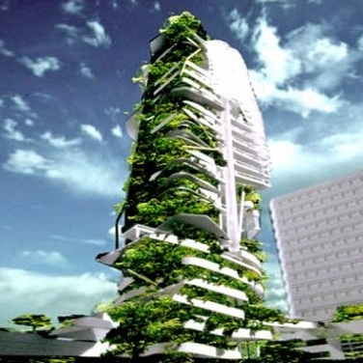
D. Innovation

Slide 32
What exactly is innovation?
Do not confuse :
Discovery
Invention,
Innovation
Distinguish :
Science (research, to understand),
Technique and technology (development),
Products and services (design, to produce and sell)
"Innovating is linking Science, Technology and Markets".

Slide 33

R&D: research programs VS development projects
Distinguish research and exploration activities (programs to develop skills) from product development processes (projects)
Reconciling two dynamics to bring highly differentiated products to market.
Increase product development productivity to keep up with sustained renewal rates (projects)
Develop capacities for exploration and development of innovative technologies (programs)

Slide 34
What is the use of innovation for a company?
Consolidate a competitive advantage
Cost or differentiation?
Transforming the rules of the competitive game
Renewal
Growth
New jobs
New markets
Responding to the challenges of society

Slide 35
In the end, what is innovation?
... to introduce new ways of doing things (producing, dreaming, selling, eating, moving, exchanging ...) in a sustainable way over time and in space.
Innovation is first and foremost social, it is a new USE that aims to become widespread.
Innovation is then economic, it is a new offer that must prove its VALUE.
Innovation is finally technological (in the broadest sense), it is a SOLUTION that allows a use - it translates into an INNOVATIVE/DOMINANT DESIGN

Slide 36
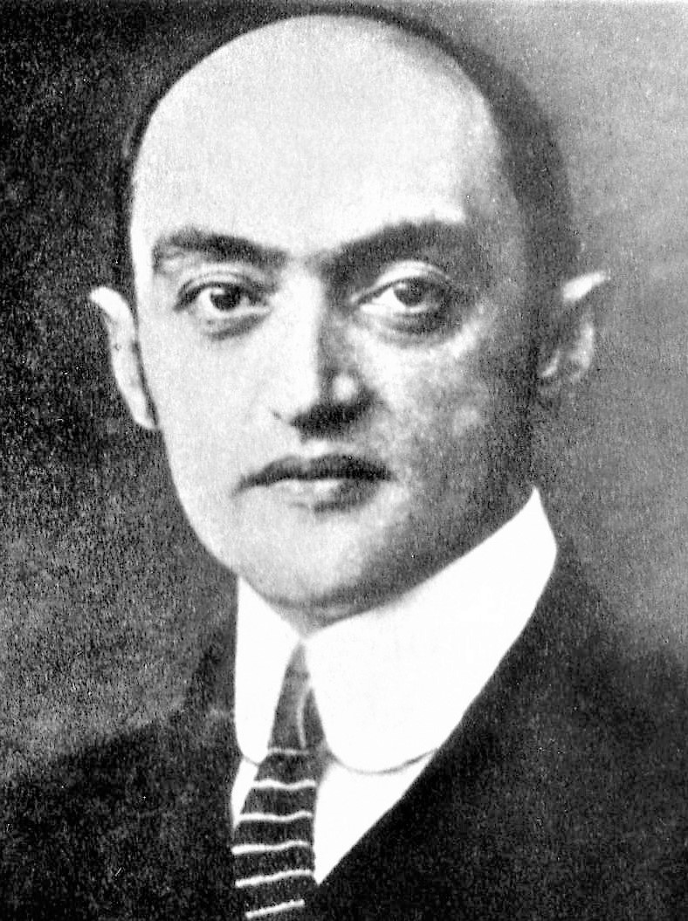
Creative destruction (Joseph Schumpeter)
Creative destruction" refers to the process that is continually at work in economies, whereby the disappearance of sectors of economic activity occurs simultaneously with the creation of new economic activities.
Innovation challenges the existing ('status quo').... in a more or less radical way!
Incremental Innovation / Radical Innovation (T)
Continuous innovation / Disruptive innovation (BM)
Innovation challenges the company's know-how and skills.
Incumbent / new comer / game changer

